Slide 1

Airline passenger Satisfaction
CS 513 - A - Knowledge Discovery and Data Mining
Group 17

Slide 2




Team Members
Dhavan Kanakia
20011563
Ritvik Jain
20009507
Rudresh Jetani
20018592
Ujas Mahesh Italia
20012646

Slide 3

Problem Statement
The airline industry faces the challenge of ensuring customer satisfaction with their services. In order to address this challenge, it is important to identify the factors that contribute to customer satisfaction or dissatisfaction. This presentation aims to analyze the provided dataset to understand the key factors that impact passenger satisfaction and develop a predictive model to help airlines improve customer satisfaction.

Slide 4
Data SET
https://www.kaggle.com/datasets/teejmahal20/airline-passenger-satisfaction
This dataset contains an airline passenger survey.
This dataset has 25 columns and 103,904 rows
The task is to determine what factors are highly correlated to a satisfied or dissatisfied/neutral passenger and to predict the customer satisfaction

Slide 5
Data pre-processing
Removing null values
Changing data types
Standardizing by scaling and normalizing the data
Feature selection by PCA

Slide 6
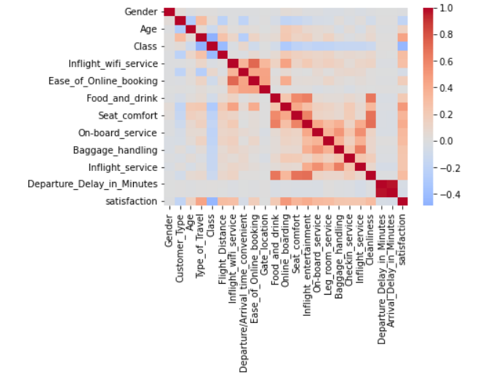
Correlation between features
Heat map representation to show case how different features columns are correlated to each to determine the relevance

Slide 7
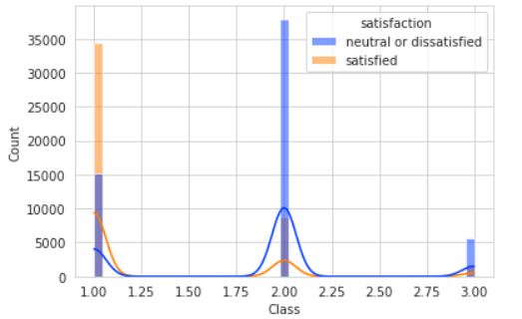
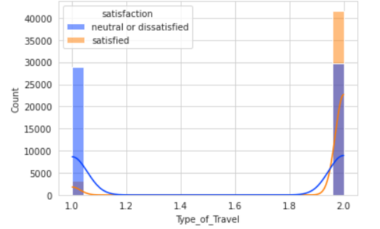
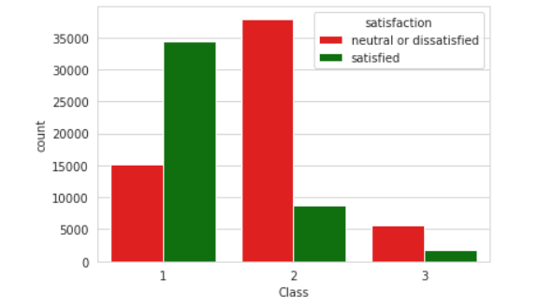
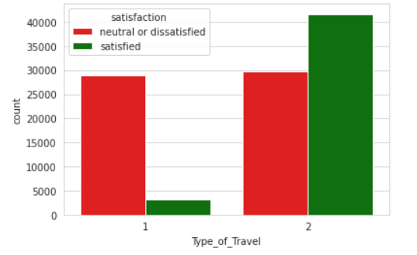

Slide 8

Classification algorithms
Naïve Bayes
Linear Regression
K Nearest Neighbor
Decision Trees
Logistic Regression
ANN
Random Forest
SVC

Slide 9
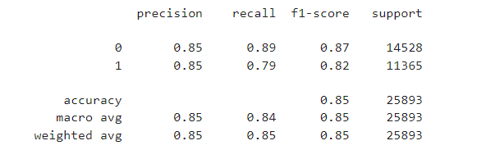
Naïve bayes

Slide 10
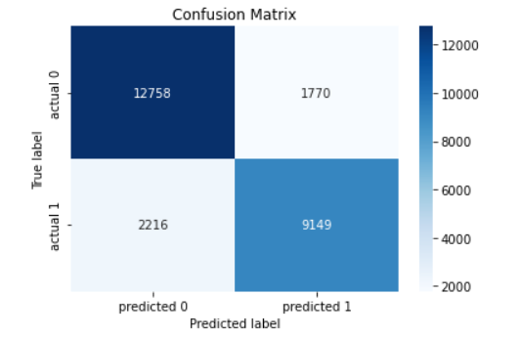
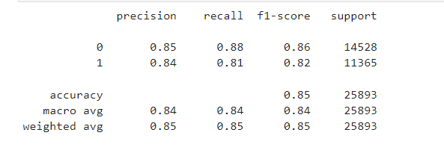
Linear regression

Slide 11
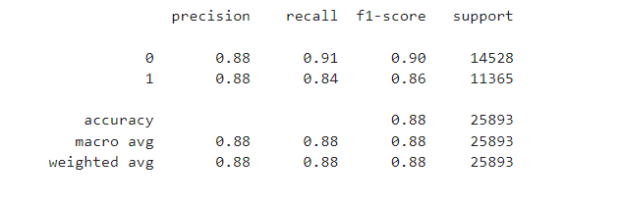
K nearest neighbor

Slide 12
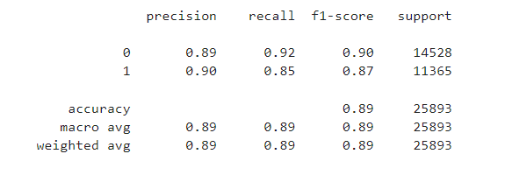
Decision trees

Slide 13
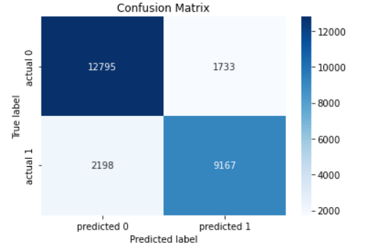
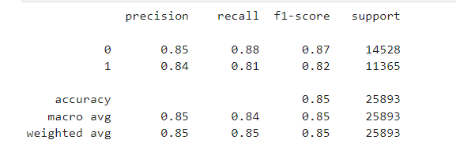
Logistic regression

Slide 14
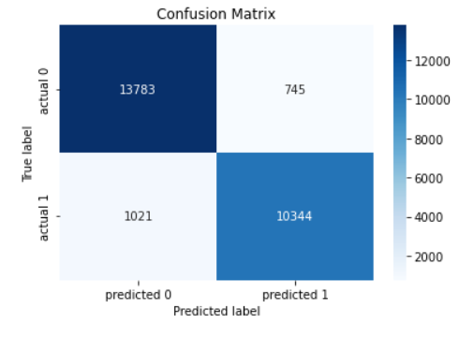
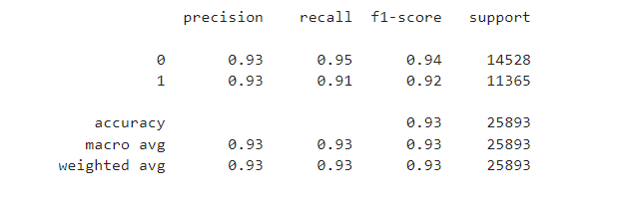
ANN

Slide 15
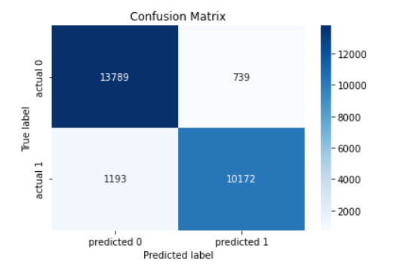
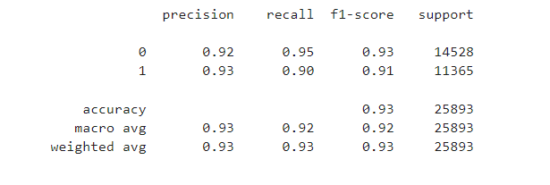
Random forest

Slide 16
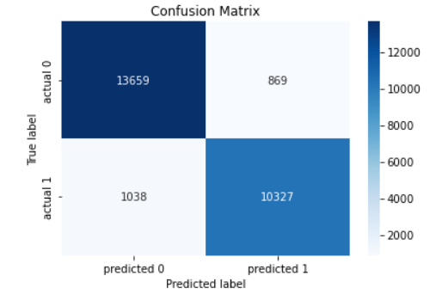
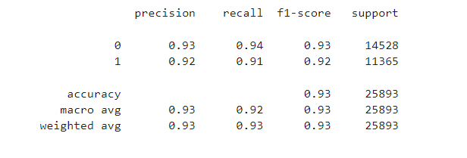
svC

Slide 17

Conclusion
top key features that impact customer satisfaction are "class, type_of_travel, customer_type”. For this dataset, SVC and ANN models have the highest overall performance, with an accuracy of 0.93 and F1-score of 0.93, followed closely by Random Forest model.

